Slide 1
Ionisation Enthalpy & Atomic Radii

Slide 2
Lesson Objectives
Define ionisation energy as the energy required to remove one mole of electrons from one mole of atoms or ions in the gas phase.
State and explain the variation in the first ionisation energy down a group and across a period in the Periodic Table.
State and explain the trend in the successive ionisation energies for an element.
State and explain the variation in atomic radius down a group and across a period in the Periodic Table.
Define electronegativity of an atom in terms of its ability to attract electrons within a covalent bond.
State and explain the variation in electronegativity down a group and across a period in the Periodic Table.
Describe and explain the variation in physical properties across a period.
Describe and explain the physical and chemical properties down a group.

Slide 3
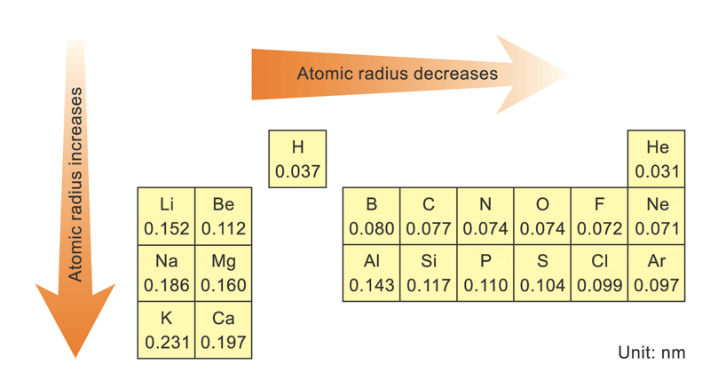
Atomic radius

Slide 4
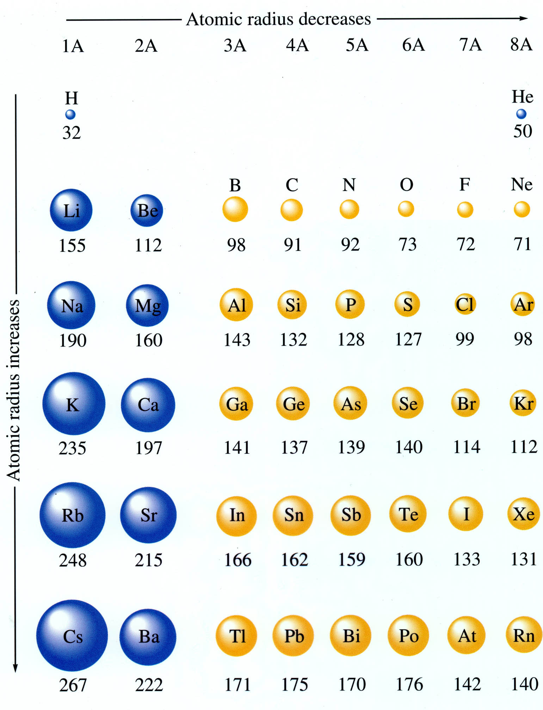
Atomic radius
Atomic radius ↓ when the Electronuclear Charge (ENC) ↑
ENC depends on
No. of protons ie. cumulative charge
Screening effect of electrons (repulsion among electrons)

Slide 5
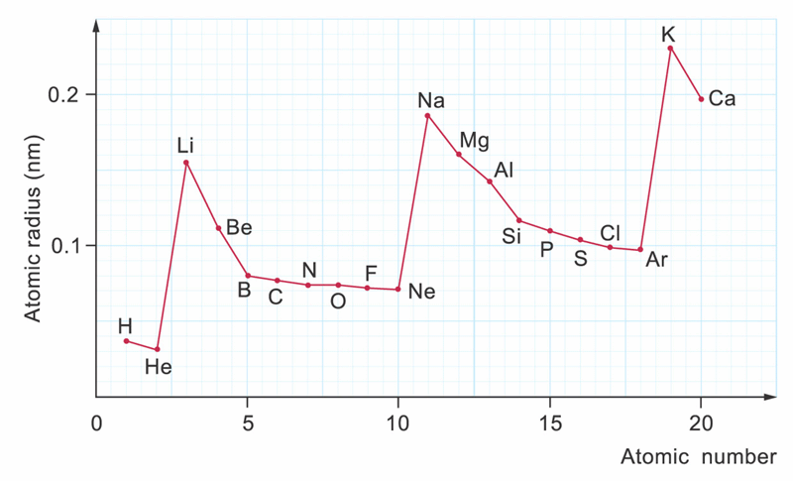
For the first 2 or 3 elements,
atomic radius ↓ more significantly because
nuclear charge ↑ sharply

Slide 6
Then, atomic radius ↓ less sharply because
screening effect is getting more important

Slide 7
Lesson Objectives
Define ionisation energy as the energy required to remove one mole of electrons from one mole of atoms or ions in the gas phase.
State and explain the variation in the first ionisation energy down a group and across a period in the Periodic Table.
State and explain the trend in the successive ionisation energies for an element.
State and explain the variation in atomic radius down a group and across a period in the Periodic Table.
Define electronegativity of an atom in terms of its ability to attract electrons within a covalent bond.
State and explain the variation in electronegativity down a group and across a period in the Periodic Table.
Describe and explain the variation in physical properties across a period.
Describe and explain the physical and chemical properties down a group.

Slide 8
REMINDER - Ions
Ions are elements with electrons added or removed cumulatively from the electron shells to create a charged particle. (ie. more electrons more charge)
If electrons are added the element becomes negative.
F → F⁻
If electrons are removed the element becomes positive.
Na → Na⁺

Slide 9
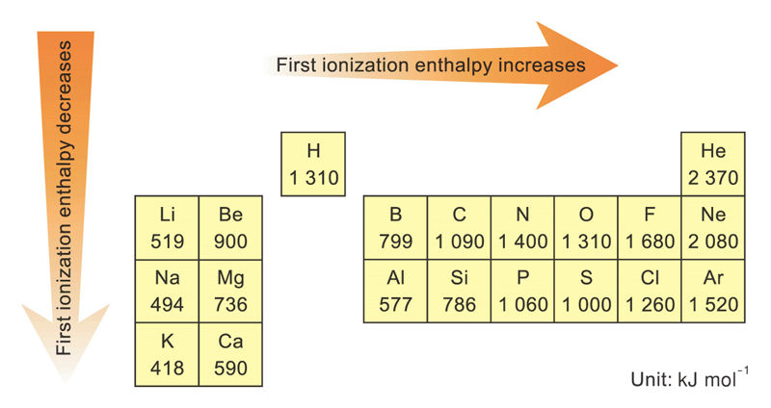
First ionisation energy (aka. Enthalpy)
Ionization energy is the energy required to remove one mole of electrons from one mole of an element in the gas phase.

Slide 10
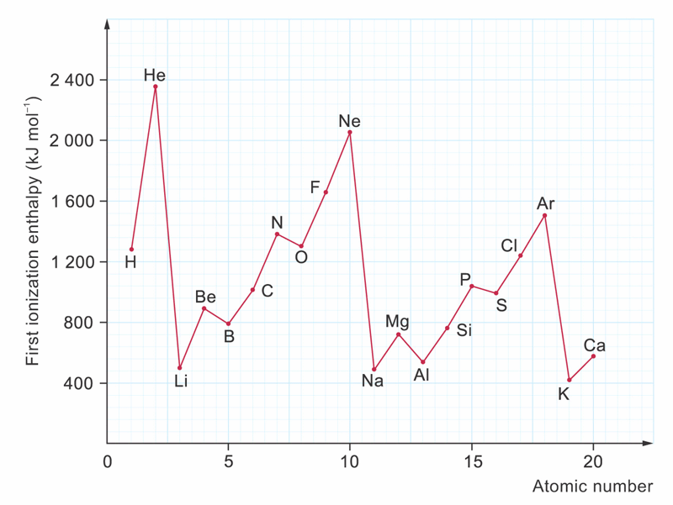
First ionisation enthalpy
Variation in the first ionization enthalpy of the first 20 elements

Slide 11
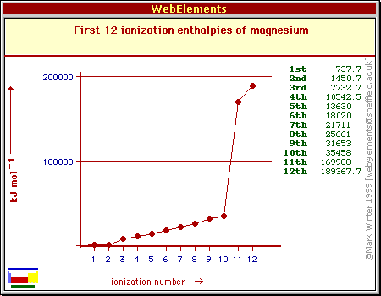
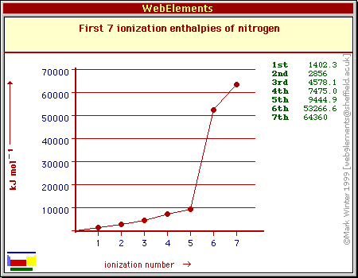
Successive ionisation enthalpy
Variation in the successive ionisation enthalpy for the elements Nitrogen and Magnesium
You could be asked to identify the element group from a graph like this. What this shows is the energy
required to remove each electron in succession. What you are looking for is a jump in energy required
in between the quantum jumps (aka electron shells).

Slide 12
Lesson Objectives
Define ionisation energy as the energy required to remove one mole of electrons from one mole of atoms or ions in the gas phase.
State and explain the variation in the first ionisation energy down a group and across a period in the Periodic Table.
State and explain the trend in the successive ionisation energies for an element.
State and explain the variation in atomic radius down a group and across a period in the Periodic Table.
Define electronegativity of an atom in terms of its ability to attract electrons within a covalent bond.
State and explain the variation in electronegativity down a group and across a period in the Periodic Table.
Describe and explain the variation in physical properties across a period. (incomplete)
Describe and explain the physical and chemical properties down a group. (incomplete)

Slide 13
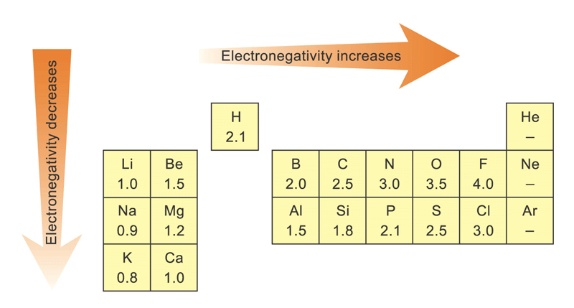
Electronegativity
The ability to attract electrons within a covalent bond

Slide 14
Electronegativity
Increases when atomic size ↓
Decreases when atomic size ↑

Slide 15
Electronegativity
Electronegativity cannot be measured directly
→ Not a physical property

Slide 16
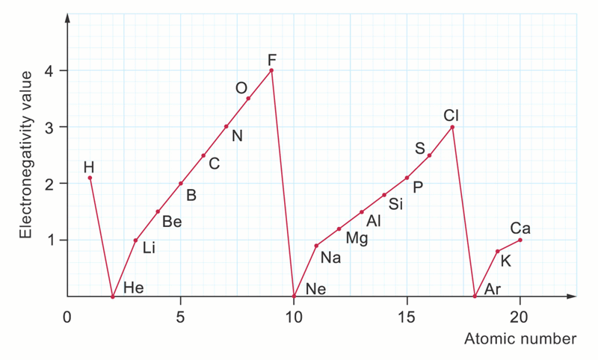
Variation in electronegativity values of the first 20 elements

Slide 17
Lesson Objectives
Define ionisation energy as the energy required to remove one mole of electrons from one mole of atoms or ions in the gas phase.
State and explain the variation in the first ionisation energy down a group and across a period in the Periodic Table.
State and explain the trend in the successive ionisation energies for an element.
State and explain the variation in atomic radius down a group and across a period in the Periodic Table.
Define electronegativity of an atom in terms of its ability to attract electrons within a covalent bond.
State and explain the variation in electronegativity down a group and across a period in the Periodic Table.
Describe and explain the variation in physical properties* (see m.p and b.p later) across a period. (incomplete)
Describe and explain the physical* (see m.p and b.p later) and chemical properties down a group. (incomplete)

Slide 18
You can practice answering questions on this…
Lucarelli Set

